Slide 1
Stack and Queue

Slide 2
Stack

Slide 3
What is a stack?
A stack is an ordered list in which insertion and deletion are done at one end, called top. The last element inserted is the first one to be deleted. Hence, it is called the Last in First out (LIFO) or First in Last out (FILO) list.

Slide 4


Linked List representation of stack
Array representation of stack

Slide 5
Push operation
Step 1: IF TOP = MAX-1
PRINT OVERFLOW
Goto Step 4
[END OF IF]
Step 2: SET TOP = TOP + 1
Step 3: SET STACK[TOP] = VALUE
Step 4: END

Slide 6
Pop operation
Step 1: IF TOP = NULL
PRINT UNDERFLOW
Goto Step 4
[END OF IF]
Step 2: SET VAL = STACK[TOP]
Step 3: SET TOP = TOP - 1
Step 4: END

Slide 7
Peek operation
Step 1: IF TOP = NULL
PRINT STACK IS EMPTY
Goto Step 3
[END OF IF]
Step 2: RETURN STACK[TOP]
Step 3: END

Slide 8
Push operation (Linked stack)
Step 1: Allocate memory for the new node and name it as NEW_NODE
Step 2: SET NEW_NODE -> DATA = VAL
Step 3: IF TOP == NULL
SET NEW_NODE -> NEXT = NULL
SET TOP = NEW_NODE
ELSE
SET NEW_NODE -> NEXT = TOP
SET TOP = NEW_NODE
[END OF IF]
Step 4: END

Slide 9
Pop operation (Linked stack)
Step 1: IF TOP = NULL
PRINT UNDERFLOW
Goto Step 5
[END OF IF]
Step 2: SET PTR = TOP
Step 3: SET TOP = TOP -> NEXT
Step 4: FREE PTR
Step 5: END

Slide 10
Application of stack
Infix to postfix conversion
Evaluation of postfix expression
Balancing symbols

Slide 11
Infix to postfix conversion algorithm
Step 1: Create a stack.
Step 2: Repeat until each character in the infix notation is scanned
IF a “(“ is encountered, push it on the stack
IF an operand (whether a digit or a character) is encountered, add it postfix expression.
IF a “)” is encountered, then
a. Repeatedly pop from stack and add it to the postfix expression until a “(“ is encountered.
b. Discard the “(“ . That is, remove the “(“ from stack and do not add it to the postfix expression
IF an operator “O” is encountered, then
a. Repeatedly pop from stack and add each operator (popped from the stack) to the postfix expression until one lower priority operator or a “(“ is encountered
b. Push the operator “O” to the stack
[END OF IF]
Step 3: Repeatedly pop from the stack and add it to the postfix expression until the stack is empty
Step 5: EXIT

Slide 12
Exercise 1: Convert the following infix expression to postfix expression.
A – (B / C + (D % E * F) / G)* H

Slide 13
Algorithm to evaluate a postfix expression
Step 1: Scan the Postfix string from left to right.
Step 2: Initialize an empty stack.
Step 3: Repeat steps 4 and 5 till all the characters are scanned.
Step 4: If the scanned character is an operand, push it onto the stack.
Step 5: If the scanned character is an operator, and if the operator is a unary operator, then pop an element from the stack. If the operator is a binary operator, then pop two elements from the stack. After popping the elements, apply the operator to those popped elements. Let the result of this operation be pushed into the stack.
Step 6: After all characters are scanned, we will have only one element in the stack.
Step 7: Return top of the stack as result.

Slide 14
Exercise 2: Convert the following infix expression to postfix expression and evaluate the postfix expression.
9 – ((3 * 4) + 8) / 4

Slide 15
Balancing of symbols checking algorithm
a) Create a stack.
b) while (end of input is not reached) {
1) If the character read is not a symbol to be balanced, ignore it.
2) If the character is an opening symbol like (, [, {, push it onto the stack
3) If it is a closing symbol like ),],}, then if the stack is empty report an error. Otherwise pop the stack.
4) If the symbol popped is not the corresponding opening symbol, report an error.
}
c) At end of input, if the stack is not empty report an error

Slide 16
Infix to prefix notation
Step 1: Scan each character in the infix expression. For this, repeat Steps 2-8 until the end of infix expression
Step 2: Push the operator into the operator stack, operand into the operand stack and ignore all the left parentheses until a right parenthesis is encountered
Step 3: Pop operand 2 from operand stack
Step 4: Pop operand 1 from operand stack
Step 5: Pop operator from operator stack
Step 6: Concatenate operator and operand 1
Step 7: Concatenate result with operand 2
Step 8: Push result into the operand stack
Step 9: END

Slide 17
Algorithm to evaluate a prefix expression
Step 1: Scan the Prefix string from right to left.
Step 2: Initialize an empty stack.
Step 3: Repeat steps 4 and 5 till all the characters are scanned.
Step 4: If the scanned character is an operand, push it onto the stack.
Step 5: If the scanned character is an operator, and if the operator is a unary operator, then pop an element from the stack. If the operator is a binary operator, then pop two elements from the stack. After popping the elements, apply the operator to those popped elements. Let the result of this operation be pushed into the stack.
Step 6: After all characters are scanned, we will have only one element in the stack.
Step 7: Return top of the stack as result.

Slide 18
Recursion

Slide 19
A recursive function is defined as a function that calls itself to solve a smaller version of its task until a final call is made which does not require a call to itself.
Base case, in which the problem is simple enough to be solved directly without making any further calls to the same function.
Recursive case, in which first the problem is divided into simpler sub-parts. Second the function calls itself but with sub-parts of the problem obtained in the first step.

Slide 20
Recursion vs Iteration
Recursion
Terminates when a base case is reached.
Each recursive call requires extra space on the stack frame (memory).
If we get infinite recursion, the program may run out of memory and result in stack overflow.
Solutions to some problems are easier to formulate recursively.
Iteration
Terminates when a condition is proven to be false.
Each iteration does not require extra space.
An infinite loop could loop forever since there is no extra memory being created.
Iterative solutions to a problem may not always be as obvious as a recursive solution.

Slide 21
void foo(int n, int sum)
{
int k = 0, j = 0;
if (n == 0) return;
k = n % 10; j = n / 10;
sum = sum + k;
foo (j, sum);
printf ("%d,", k);
}
int main ()
{
int a = 2048, sum = 0;
foo (a, sum);
printf ("%d\n", sum);
return 0;
}

Slide 22
int f(int n)
{
static int i = 1;
if (n >= 5)
return n;
n = n+i;
i++;
return f(n);
}
Predict the value returned by f(1).

Slide 23
int f(int n)
{
static int r = 0;
if (n <= 0) return 1;
if (n > 3)
{
r = n;
return f(n-2)+2;
}
return f(n-1)+r;
}
What will be the value of f(5)?

Slide 24
Types of Recursion
Direct Recursion
A function is said to be directly recursive if it explicitly calls itself.
int func (int n)
{
if (n == 0)
return n;
else
return (func (n–1));
}

Slide 25
Indirect Recursion
A function is said to be indirectly recursive if it contains a call to another function which ultimately calls it.
int func1 (int n)
{
if (n == 0)
return n;
else
return Func2(n);
}
int func2(int x)
{
return func1(x–1);
}

Slide 26
Tail Recursion
A recursive function is said to be tail recursive if no operations are pending to be performed when the recursive function returns to its caller. When the called function returns, the returned value is immediately returned from the calling function.
int fact(int n)
{
if (n == 1)
return 1;
else
return (n * fact(n–1));
}

Slide 27
Tail Recursion contd.
int fact(n)
{
return fact1(n, 1);
}
int fact1(int n, int res)
{
if (n == 1)
return res;
else
return fact1(n–1, n*res);
}

Slide 28
Towers of Hanoi puzzle
Only one disk may be moved at a time.
Each move consists of taking the upper disk from one of the rods and sliding it onto another rod, on top of the other disks that may already be present on that rod.
No disk may be placed on top of a smaller disk.

Slide 29
Algorithm for solving Towers of Hanoi puzzle
Move the top n – 1 disks from Source to Auxiliary tower,
Move the nth disk from Source to Destination tower,
Move the n – 1 disks from Auxiliary tower to Destination tower.
Transferring the top n – 1 disks from Source to Auxiliary tower can again be thought of as a fresh problem and can be solved in the same manner.

Slide 30
Backtracking

Slide 31
Backtracking is an improvement of the brute force approach. It systematically searches for a solution to a problem among all available options. In backtracking, we start with one possible option out of many available options and try to solve the problem if we are able to solve the problem with the selected move then we will print the solution else we will backtrack and select some other option and try to solve it. If none if the options work out we will claim that there is no solution for the problem.

Slide 32
Backtracking example
Let's take a situation. Suppose you are standing in front of three tunnels, one of which is having a bag of gold at its end, but you don't know which one. So you'll try all three.
First go in tunnel 1, if that is not the one, then come out of it, and go into tunnel 2, and again if that is not the one, come out of it and go into tunnel 3.
So basically in backtracking we attempt solving a sub-problem, and if we don't reach the desired solution, then undo whatever we did for solving that sub-problem, and try solving another sub-problem.

Slide 33
N-Queens puzzle
Place the queens column wise, start from the left most column
If all queens are placed.
return true and print the solution matrix.
Else
Try all the rows in the current column.
Check if queen can be placed here safely if yes mark the current cell in solution matrix as 1 and try to solve the rest of the problem recursively.
If placing the queen in above step leads to the solution return true.
If placing the queen in above step does not lead to the solution , BACKTRACK, mark the current cell in solution matrix as 0 and return false.
If all the rows are tried and nothing worked, return false and print NO SOLUTION.

Slide 34
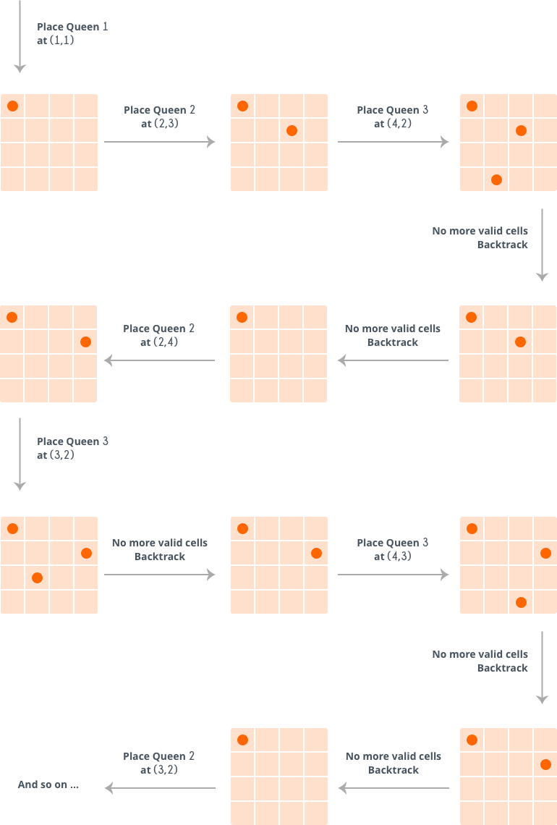

Slide 35
Queue

Slide 36
What is a queue?
A queue is an ordered list in which insertions are done at one end (rear) and deletions are done at other end (front). The first element to be inserted is the first one to be deleted. Hence, it is called First in First out (FIFO) or Last in Last out (LILO) list.

Slide 37
Applications of queue
Operating systems schedule jobs (with equal priority) in the order of arrival (e.g., a print queue)
Simulation of real-world queues such as lines at a ticket counter or any other first come first-served scenario requires a queue
Multiprogramming
Waiting times of customers at call center

Slide 38


Linked List representation of queue
Array representation of queue
Front
Rear

Slide 39
Linked List representation of queue
struct node
{
int data;
struct node *next;
};
struct queue
{
struct node *front;
struct node *rear;
};

Slide 40
Main Queue Operations
EnQueue(int data): Inserts an element at the end of the queue
DeQueue(): Removes and returns the element at the front of the queue

Slide 41
EnQueue operation
Step 1: IF REAR = MAX-1
PRINT OVERFLOW
Goto step 4
[END OF IF]
Step 2: IF FRONT = -1 and REAR = -1
SET FRONT = REAR = 0
ELSE
SET REAR = REAR + 1
[END OF IF]
Step 3: SET QUEUE[REAR] = NUM
Step 4: EXIT

Slide 42
DeQueue operation
Step 1: IF FRONT = -1 OR FRONT > REAR
PRINT UNDERFLOW
ELSE
SET VAL = QUEUE[FRONT]
SET FRONT = FRONT + 1
[END OF IF]
Step 2: EXIT

Slide 43
EnQueue operation (Linked list)
Step 1: Allocate memory for the new node and name it as PTR
Step 2: SET PTR -> DATA = VAL
Step 3: IF FRONT = NULL
SET FRONT = REAR = PTR
SET FRONT -> NEXT = REAR -> NEXT = NULL
ELSE
SET REAR -> NEXT = PTR
SET REAR = PTR
SET REAR -> NEXT = NULL
[END OF IF]
Step 4: END

Slide 44
DeQueue operation (Linked list)
Step 1: IF FRONT = NULL
PRINT Underflow
Go to Step 5
[END OF IF]
Step 2: SET PTR = FRONT
Step 3: SET FRONT = FRONT -> NEXT
Step 4: FREE PTR
Step 5: END

Slide 45
Types of queues
Circular queue
Deques
Priority queue

Slide 46
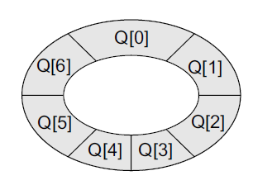
Circular queue

Slide 47
Insertion in circular queue
Step 1: IF FRONT = 0 and REAR = MAX – 1
PRINT OVERFLOW
Goto step 4
[End OF IF]
Step 2: IF FRONT = -1 and REAR = -1
SET FRONT = REAR = 0
ELSE IF REAR = MAX - 1 and FRONT != 0
SET REAR = 0
ELSE
SET REAR = REAR + 1
[END OF IF]
Step 3: SET QUEUE[REAR] = VAL
Step 4: EXIT

Slide 48
Insertion in circular queue
Step 1: IF FRONT = 0 and REAR = MAX – 1 OR REAR=FRONT-1
PRINT OVERFLOW
Goto step 4
[End OF IF]
Step 2: IF FRONT = -1 and REAR = -1
SET FRONT = REAR = 0
ELSE IF REAR = MAX - 1 and FRONT != 0
SET REAR = 0
ELSE
SET REAR = REAR + 1
[END OF IF]
Step 3: SET QUEUE[REAR] = VAL
Step 4: EXIT

Slide 49
Deletion from circular queue
Step 1: IF FRONT = -1
PRINT UNDERFLOW
Goto Step 4
[END of IF]
Step 2: SET VAL = QUEUE[FRONT]
Step 3: IF FRONT = REAR
SET FRONT = REAR = -1
ELSE
IF FRONT = MAX -1
SET FRONT = 0
ELSE
SET FRONT = FRONT + 1
[END of IF]
[END OF IF]
Step 4: EXIT

Slide 50
Deque
A deque is a list in which the elements can be inserted or deleted at either end. It is also known as a head-tail linked list because elements can be added to or removed from either the front (head) or the back (tail) end.

Slide 51
Two variants of a double-ended queue
Input restricted deque: In this deque, insertions can be done only at one of the ends, while deletions can be done from both ends.
Output restricted deque: In this deque, deletions can be done only at one of the ends, while insertions can be done on both ends.

Slide 52
Insertion at right in Deque
Step 1: IF LEFT = 0 and RIGHT = MAX – 1 or LEFT=RIGHT+1
PRINT OVERFLOW
Goto step 4
[End OF IF]
Step 2: IF LEFT = -1 and RIGHT = -1
SET LEFT = RIGHT = 0
ELSE IF RIGHT = MAX - 1
SET RIGHT = 0
ELSE
SET RIGHT = RIGHT + 1
[END OF IF]
Step 3: SET DEQUE[RIGHT] = VAL
Step 4: EXIT

Slide 53
Insertion at left in Deque
Step 1: IF LEFT = 0 and RIGHT = MAX – 1 or LEFT=RIGHT+1
PRINT OVERFLOW
Goto step 4
[End OF IF]
Step 2: IF LEFT = -1 and RIGHT = -1
SET LEFT = RIGHT = 0
ELSE IF LEFT = 0
SET LEFT = MAX-1
ELSE
SET LEFT = LEFT - 1
[END OF IF]
Step 3: SET DEQUE[LEFT] = VAL
Step 4: EXIT

Slide 54
Deletion from left in Deque
Step 1: IF LEFT = -1
PRINT UNDERFLOW
Goto step 3
[End OF IF]
Step 2: IF LEFT = RIGHT
SET LEFT = RIGHT = -1
ELSE IF LEFT = MAX-1
SET LEFT = 0
ELSE
SET LEFT = LEFT + 1
[END OF IF]
Step 3: EXIT

Slide 55
Deletion from right in Deque
Step 1: IF LEFT = -1
PRINT UNDERFLOW
Goto step 3
[End OF IF]
Step 2: IF LEFT = RIGHT
SET LEFT = RIGHT = -1
ELSE IF RIGHT = 0
SET RIGHT = MAX-1
ELSE
SET RIGHT = RIGHT - 1
[END OF IF]
Step 3: EXIT

Slide 56
Priority queue
A priority queue is a data structure in which each element is assigned a priority. The priority of the element will be used to determine the order in which the elements will be processed.
An element with higher priority is processed before an element with a lower priority.
Two elements with the same priority are processed on a first-come-first-served (FCFS) basis.

Slide 57

Priority queue

Slide 58
Insertion in priority queue
Step 1: Create a new node
Step 2: SET NEW_NODE->DATA=VAL
Step 3: SET NEW_NODE->PRIORITY=PRI
Step 4: IF START = NULL or PRI< START->PRIORITY
SET NEW_NODE-> NEXT= START
SET START= NEW_NODE
ELSE
SET PTR = START
WHILE(PTR->NEXT!=NULL and PTR->NEXT-> PRIORITY<=PRI)
PTR=PTR->NEXT
[END OF WHILE]
SET NEW_NODE-> NEXT=PTR->NEXT
SET PTR-> NEXT=NEW_NODE
[END OF IF]
Step 5: EXIT

Slide 59
Deletion from priority queue
Step 1: IF START = NULL
PRINT UNDERFLOW
Goto step 2
ELSE
SET PTR=START
SET START=START->NEXT
FREE(PTR)
[End OF IF]
Step 2: EXIT

